Slide 1
Java Security: SSO
-By Ganesh Jadhav

Slide 2
PreRequisites
Java, spring boot
OAuth 2.0
OpenId Connect
A bit about JWT

Slide 3
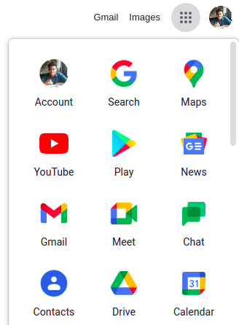
What is SSO
Single sign-on (SSO) is an authentication scheme that allows a user to login with a single ID and password to any of several related, yet independent, software systems.[from wikipedia]

Slide 4
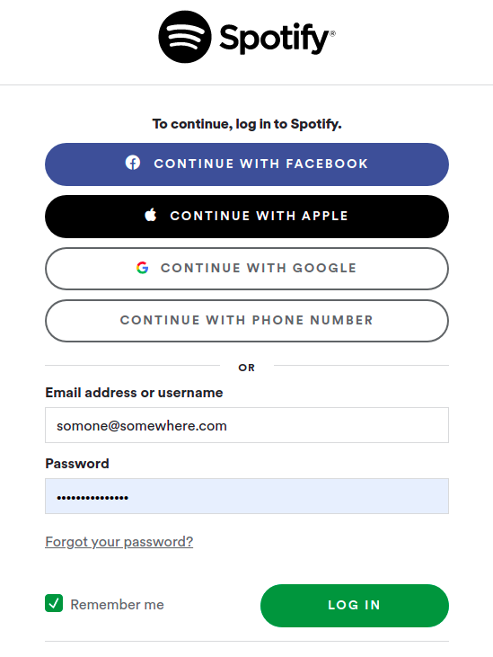
Social SSO
Google, linkedIn, facebook let end users login to 3rd party apps. (like spotify) using their credentials

Slide 5
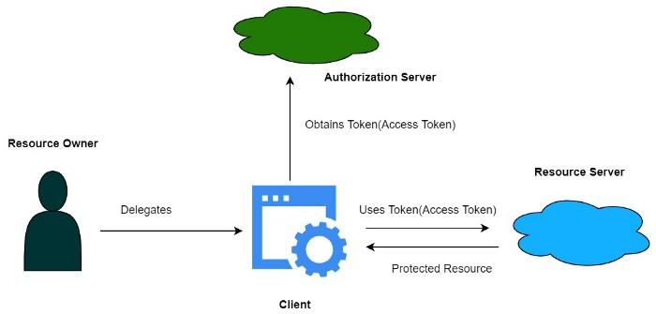
A bit about OAuth 2.0
Example-
client=spotify
Authorization server = FB
Resource server = FB
Resource=profile pic, name
NOTE-OAuth is authorization framework, not authentication. But some parties use it for authentication anyway, this concept is pseudo authentication

Slide 6
A bit about OpenID Connect
OpenID Connect is layer on top of OAuth 2.0 protocol
Uses JWT(called ID token) to standardize areas that OAuth leaves up choice example-scope, endpoint discovery

Slide 7
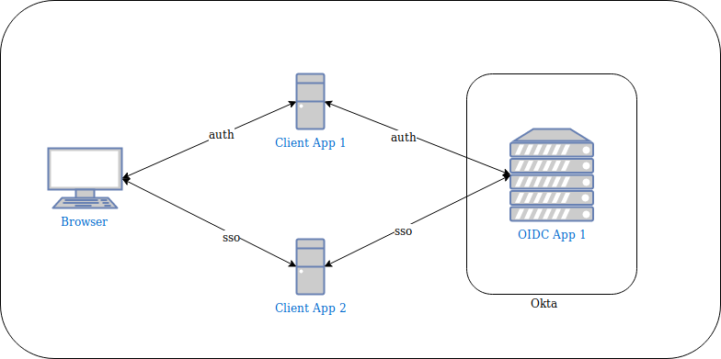
Deep Diving into SSO

Slide 8
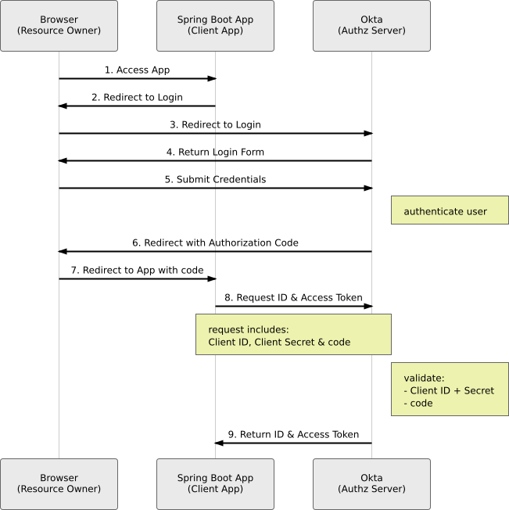
Deep Diving into SSO
In the image - Authorization code flow
The Spring Boot app never sees the username and password.
want to separate concerns, such as authentication, from the business logic of the application.

Slide 9
Advantages & disadvantages
Advantages:
It enables users to remember and manage fewer passwords and usernames for each application
It streamlines the process of signing on and using applications -- no need to re-enter passwords
Helps avoid phishing
Disadvantages:
It does not address certain levels of security each application sign-on may need.
If availability is lost, then users are locked out of the multiple systems connected to the SSO.

Slide 10
Some SSO vendors
Okta
OneLogin
Rippling

Slide 11
References
Approaches to SSO with OAuth 2 & OpenID Connect(Okta dev. Blog for overview)
Quick approach for adding SSO to spring project(Okta dev. Blog for implementation details)
Spring docs for SSO
Medium blog on concepts relating to SSO
OAuth & OIDC(has good pictorial representations of concepts)
OAuth 2.0, OpenId Connect & SAML
spring-oidc-logout-options(Okta dev. Blog for logging out)

